Slide 1
Using Drug Resources
Nancy Clark, M.Ed, Director Medical Informatics Education
, M.D. Informatics Curriculum Director Regional Campus
Notes:
[Do slides 1-12 in the first 10 minutes. Don’t spend a lot of time on these or you will never finish this workshop.]

Slide 2
Objectives
Find the Drug Reference Library web page
Identify teaching opportunities for medical students around drug questions
Locate basic prescription, OTC and herbal drug information (dosage, indication, etc.) online and on the PDA
Identify the types of information and tools in the resources
Utilize drug tools (interactions, calculators, pill ID, …)

Slide 3
Mentioning
Patient Education Handouts on drugs
Drug News: recalls, dosing and delivery changes, safety issues, FDA approvals, etc.
Research articles on clinical trials, drug toxicology, etc.
Notes:
I have hidden this to save some time.

Slide 4
Handouts
Evaluations – please complete pre-workshop evaluation
Drug References Handout
Worksheet
Top 200 Drugs Prescribed www.rxlist.com

Slide 5
Using the green Worksheet as we go thru the workshop, identify drug questions you can use with students.

Slide 6
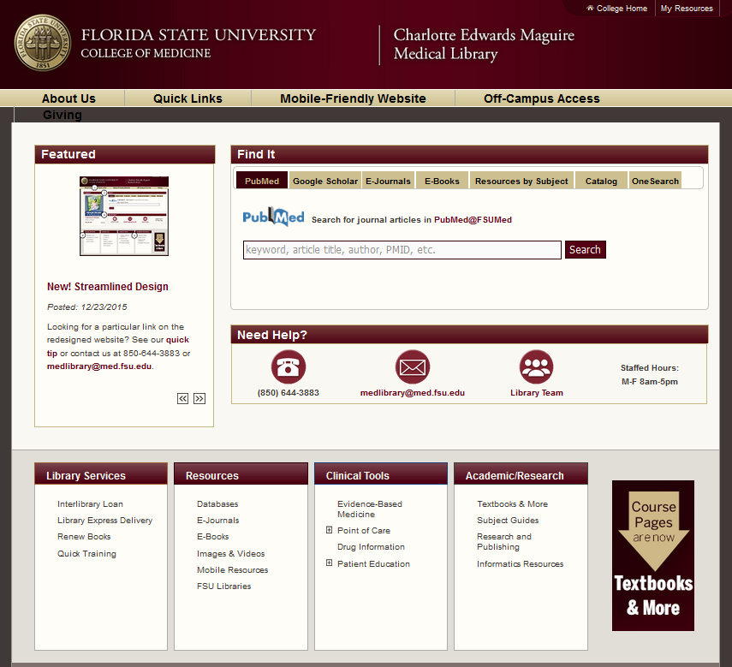
New Library Webpage
Notes:
Different ways to find the resources.

Slide 7
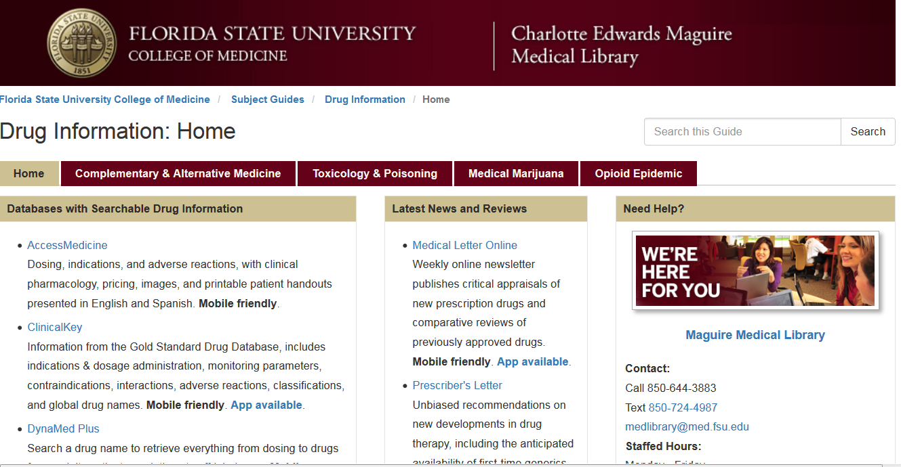
Library Web Site
Notes:
Use this page as the launching point for all of the drug resources. They are easier to find than the scroll box which is going away with the new interface this fall.

Slide 8
Subscription Drug Resources
Access Medicine’s Drugs (Lexi Drug)
Dynamed Plus
Epocrates Online or App
Facts and Comparisons (web)
Harriet Lane
Johns Hopkins ABX guide
PEPID
Clinical Key (Clinical Pharmacology)
Natural Medicines
Pediatric Care Online
Journals, News and periodical databases
Prescriber’s Letter
Medical Letter
Notes:
“We subscribe to a number of excellent drug related resources. Due to our limited time tonight, we will only concentrate the training on three of these, (click) Epocrates, PEPID and Facts and Comparisons. For those of you familiar with the content in Gold Standard Multimedia’s Clinical Pharmacology, you can find this content in MDConsult under their Drug tab. “
[don’t read the slide to the audience. Just let them read the resources.]

Slide 9
Mobile Drug Resources Apps
Epocrates Essentials
Dynamed Plus
Johns Hopkins ABX Guide (uCentral)
Harriet Lane (uCentral)
Medical Letter
Natural Medicines Comprehensive Database
Pediatric Care Online
PEPID
Available free to all faculty
Notes:
These are available in all of the formats listed above except Epocrates, which is likely to change shortly.

Slide 10
Free Drug Resources
Medscape (App)
CDC Vaccinations (App)
CDC Travelers' Health http://wwwn.cdc.gov/travel/
Toxnet (poisons and toxic agents) http://toxnet.nlm.nih.gov/
Notes:
We will mention two free drug references, Johns Hopkins ABX guide and Shots. There are other free drug references that deal with specific content like the Toxnet at NLM, or the CDC’s travelers health page. Drugs.com has good content for consumers, but you have to put up with a lot of ads.
Medscape is turning out to be a very nice product. They include the PEPID drug reference. Lacking are pill identifier and the dosage calulator, but the interface allows you to add any drug you are looking at to the interaction tool with a button at the bottom of the screen.

Slide 11
Student Issues
Taught generic names
Preceptors/clerkship faculty use brand names
Don’t learn dosing in Pharmacology. Get a little in D2.
When do they learn how to write a prescription? D3
Do not understand abbreviations (PO, PRN, etc.)
Renal and hepatic dosing introduced 2nd yr
What weakness do you see with students?
What kinds of questions do you ask students to look up regarding drugs?
Notes:
I Personally want to say something about prescription writing. Then tell…

Slide 12
Epocrates
P | Rx Monographs
P | OTC Monographs
P | Alt Meds Monographs
P | Drug Interaction Tool
P | Drug Costs
P | Dosage Calculator
P | Formulary Tool
P | Pill Identifier
P | Antibiotics Guide
P | Immunizations

Slide 13
Content Differences
Epocrates Online
Epocrates App
Drugs
Diseases
Interaction Checker
EBMcalc
Pill ID
Tables
Selected Patient Education Resources
DDX
Drugs
Diseases
Interaction Checker
EBMcalc
Pill ID
Tables
Lab Manual
Infectious Disease
ICD-9 and CPT codes
Guidelines

Slide 14
Epocrates Drug Monographs
Rx – OTC – Alt
Costs provided
Patient Ed Handouts online only
Dosage Calculator linked to dose/kg in app
Pill pictures require internet connection on app
Teaching opportunities:
Prescription writing
Pill pictures => patient’s ability to swallow
Abbreviations – in Help menu
Review pharmacology
Evaluating patient’s adverse reactions
Notes:
Show a typical drug monograph on the other screen using either the iPad or online.

Slide 15
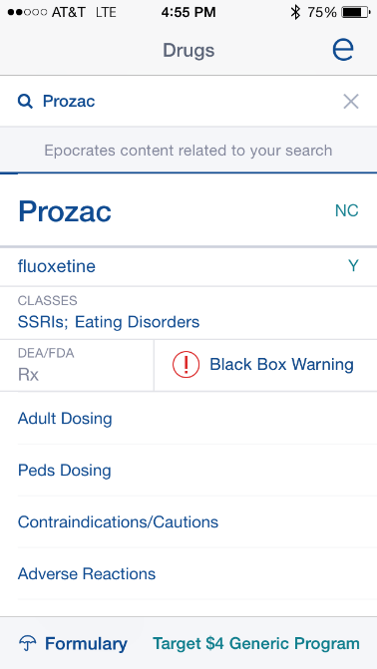
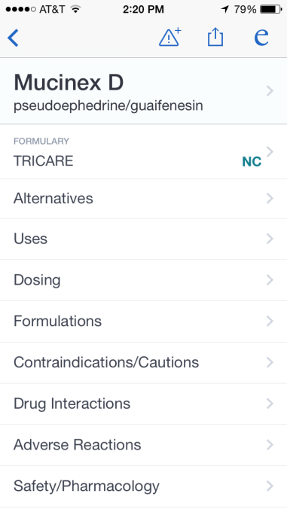
Alt Meds
Comparing Sub Categories
Rx
OTC
Add to Favorites
Add to interaction

Slide 16
Exercises for Practice
Using Epocrates
What is the starting dose of lisinopril to treat HTN if the patient is not on a diuretic? (dose)
How much does one month supply of Cymbalta 60 mg (30-ea) cost?
What are the off label indications for Ativan (adult)? ( indicates off label)
How do you write a prescription for 750 mg PO q12 of ciprofloxacin for a patient that can’t swallow large pills?
Notes:
Demo looking these up

Slide 17
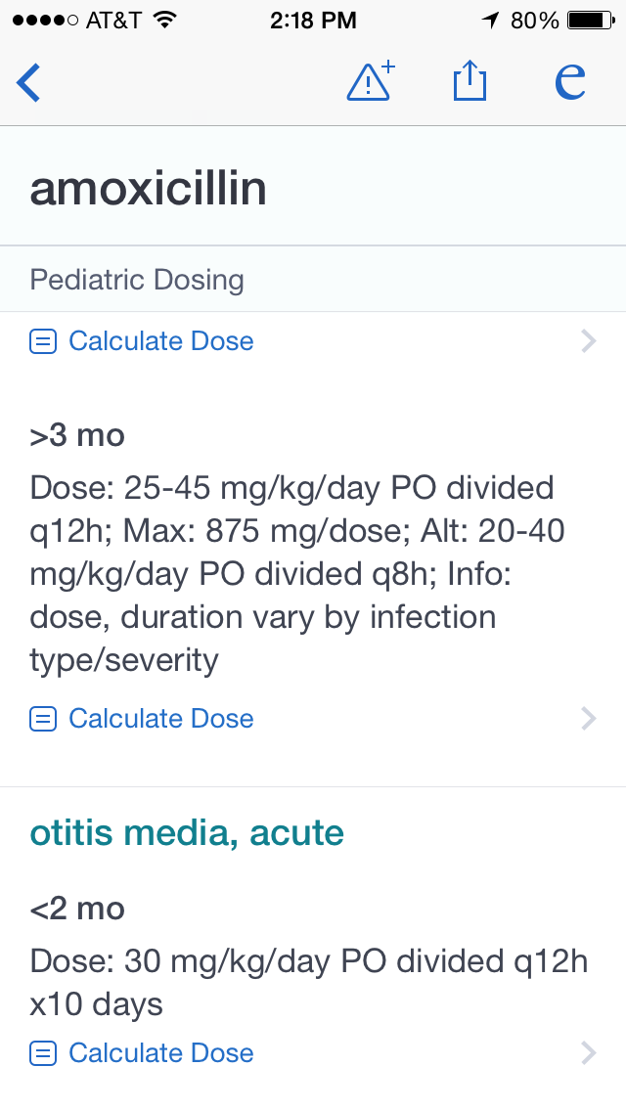
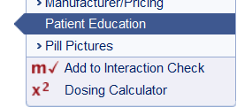
Dosage Calculators in Epocrates
Mobile and online Dosage Calculator
http://www.medcalc.com/pedidose.html
Teaching opportunity
Considerations
Liquid vs tablet…
Forms available
Notes:
Demo calculating a dose. Emphasize that students need time to look these things up when they start. Give them some time.

Slide 18
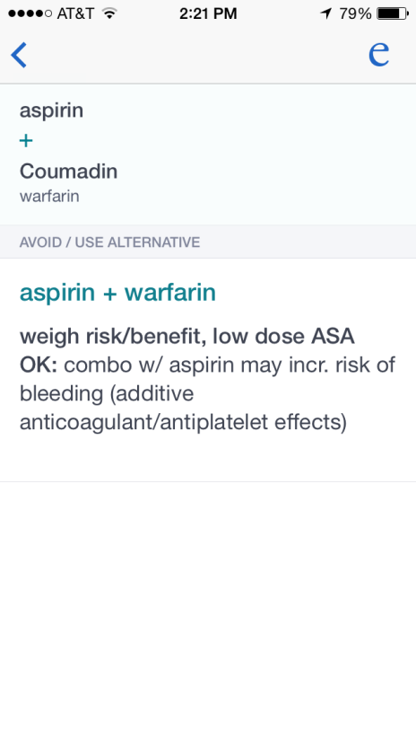
Epocrates Interaction Check
OTC, Alt meds, Rx and limited foods
Teaching opportunity
Classifications
Caution
Monitor
Avoid/Use Alternative
Contraindicated
Include patient’s OTC, alt meds, & foods in check

Slide 19
Exercises for Practice
Epocrates PDA: lisinopril, metformin, Tylenol Cold and Flu Severe, and hydrochlorothiazide
Add lithium
Peds example: isoniazid, rifampin, ethambutol, acetaminophen

Slide 20
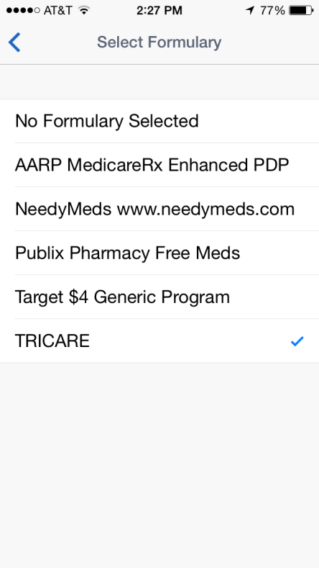
Epocrates Formularies
All available online
Must select payers to put on mobile devices
Go to Epocrates.com
Manage My Account
Pick Formularies
Sync/update to add
Teaching Opportunity
Find alternatives
Discuss considerations

Slide 21
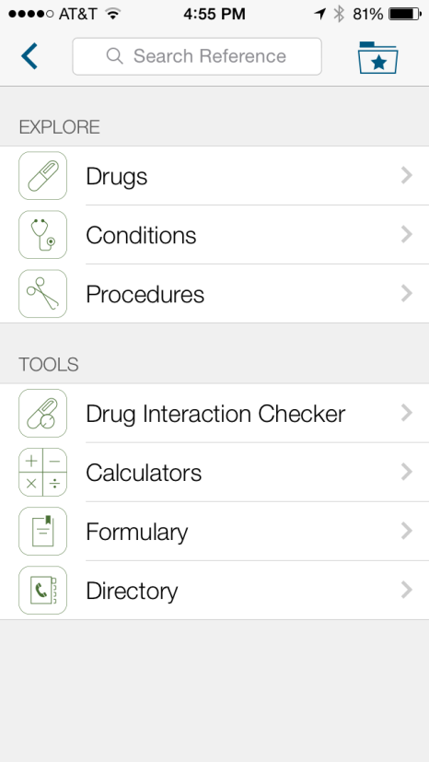
Medscape Mobile Version
Now contains formularies

Slide 22
Exercises for Practice
Using Formulary Tools on Epocrates online or app
I have a patient with H. Pylori who has BCBS of GA 3 Tier who needs a low copay. Which of the treatments are covered by BCBS low copay? Look up drugs by class > gastrointestinal> H. Pylori.
I have a depressed patient with no health insurance who is indigent. Which SSRI can they get for $4 at Target?

Slide 23
Exercises for Practice
A 65 year-old female with osteoporosis is on Boniva. She has recently changed to AARP Medicare Complete MA. Can she continue taking Boniva? Are there lower cost choices?

Slide 24
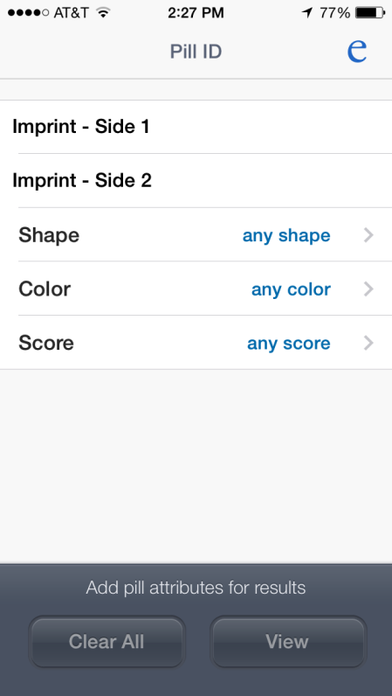
Epocrates Pill Identifier
Brand names easy
Generics iffy
Teaching opportunity
Sack of pills
Use different resources
Imprints work best
If Epocrates doesn’t have it, try Pepid or Facts and Comparisons

Slide 25
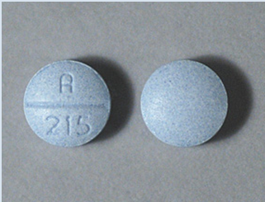
Exercises for Practice
What is this pill?

Slide 26
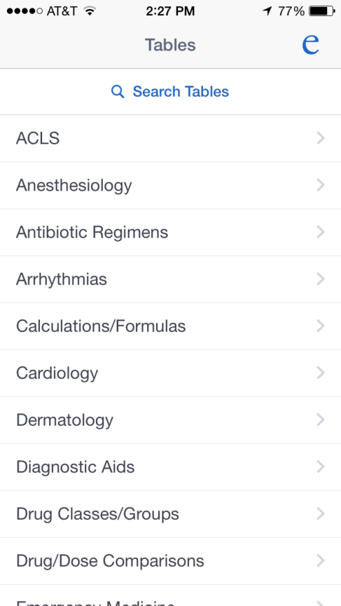
Epocrates Tables
Lots of teaching opportunities
Vaccinations
Drug/dose comparisons: topical steroids, opiates, ACE
Give students time to look up

Slide 27
Exercises for Practice
Using any of the Immunizations tools:
Patient has planned a mission trip to Central America. What immunizations does she need?
Patient has a rash on hands, likely contact derm, but 1% OTC hydrocortisone not working. What topical steroid should we try next?

Slide 28
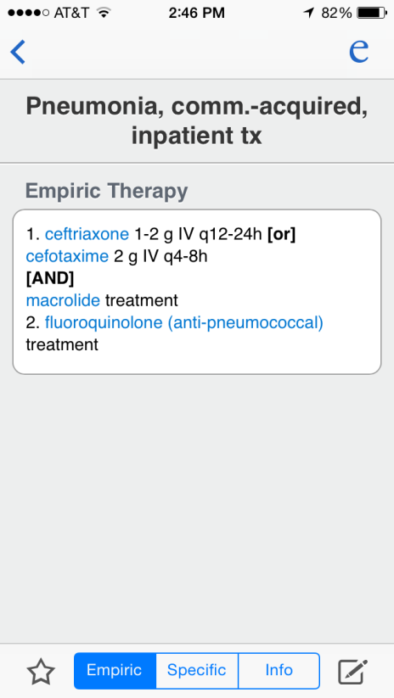
Epocrates Infectious Disease (ID) Tool
Look up Dx only
Treatment choices:
Empiric
Specific to bug
Other Info
Linked to drug monographs (blue)
Teaching opportunities:
Depends on level of student (Yr1 vs Yr2/3)
Emphasize allergies, side effects, Pregnancy class

Slide 29
PEPID Drug Information and tools
P | Rx Monographs
P | OTC Monographs
P | Alt Meds Monographs
P | Drug Interaction Tool
 | Drug Costs/Formulary
P | Dosage Calculator
P | Drug Allergy Checker
P | Pill Identifier
P | IV Compatibility
P | Immunizations
P | Beers List

Slide 30
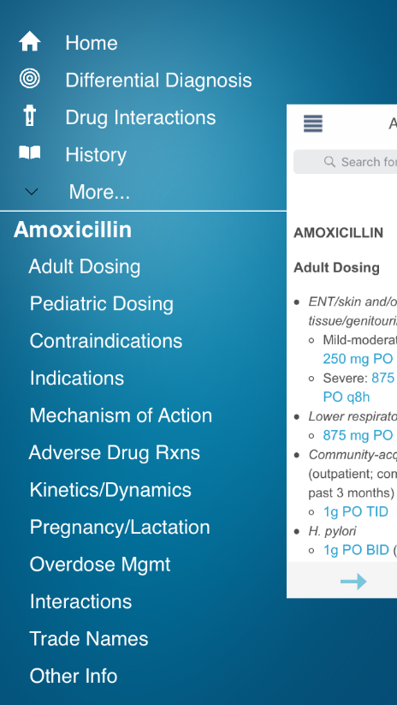
PEPID Drug Monographs
OTC, Alt and Rx
Adverse reactions include %ages
Interactions not listed, must use interaction tool.
Kinetics/Dynamics included
Include evidence-based inquiries
Tap dose to get dosage calculator
Overdose mgmt included

Slide 31
PEPID Drugs
Teaching Opportunities
Generic/Brand names…Trade names listed for all generics.
Getting a side effects history…Frequency of side effects
Overdose management issues
Contraindication considerations (much more detail)
Kinetics/Dynamics
Geriatric considerations (send to Beers List)
Notes:
Look up a trade name and you get the generic monograph.

Slide 32
Exercises for Practice
Using PEPID online or PDA
What percentage of people will have dizziness while taking Topamax?
What are the symptoms of a Prozac OD?
You have a child with otitis media for whom you need to give PO amoxicillin. The child weighs 62 Lbs. How many ml of 250 mg/5 ml should you prescribe per dose?

Slide 33
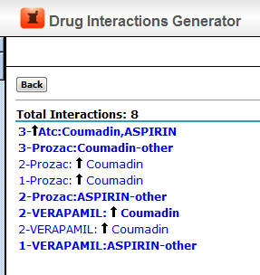
PEPID Interaction Tool
1 – 5 point system for severity
1-Minor or non-significant interaction
2-Significant interaction possible, monitor closely
3-Possible serious or life-threatening interaction. Monitor closely. Use alternatives if available.
4-High likelihood serious or life-threatening interaction. Contraindicated unless benefits outweigh risks and no alternatives available.
5-Never use combination.

Slide 34
Exercises for Practice
digoxin, furosemide, lisinopril, grapefruit
lisinopril, metformin, hydrochlorothiazide, alcohol
Peds example: isoniazid, rifampin, ethambutol, acetaminophen

Slide 35
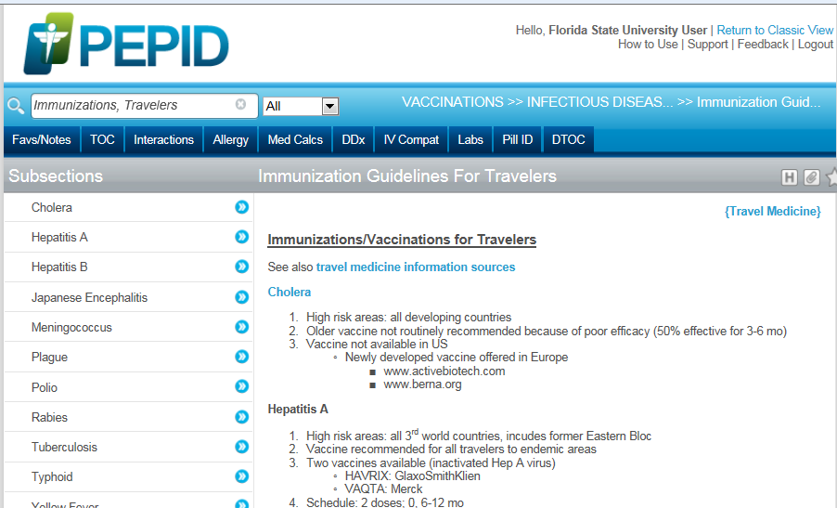
Immunizations

Slide 36
Facts and comparisons
P | Rx Monographs
P | OTC Monographs
P | Alt Meds Monographs
P | Drug Interaction Tool
 | Drug Costs
 | Dosage Calculator
 | Formulary Tool
P | Pill Identifier
 | Antibiotics Guide
P | Immunizations

Slide 37
Facts and Comparisons
Online only
Detailed
For pharmacists
Research presented
Comparison tables
Nice tools
Notes:
Drug Categories are under Drug Facts & comparisons.

Slide 38
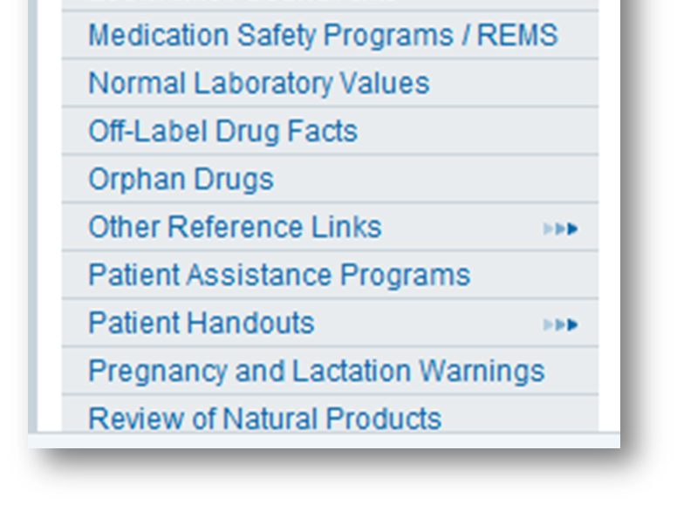
Facts and Comparisons eAnswers
Browse Resources
Notes:
Drug Facts and Comparisons

Slide 39
Drug Facts and Comparisons Monographs
Linked to Class Monograph and Tables and breadcrumbs
Patient Handouts
Contain aftermarket adverse reactions
Evidence of efficacy
Patient Information includes advice to patient about this drug.

Slide 40
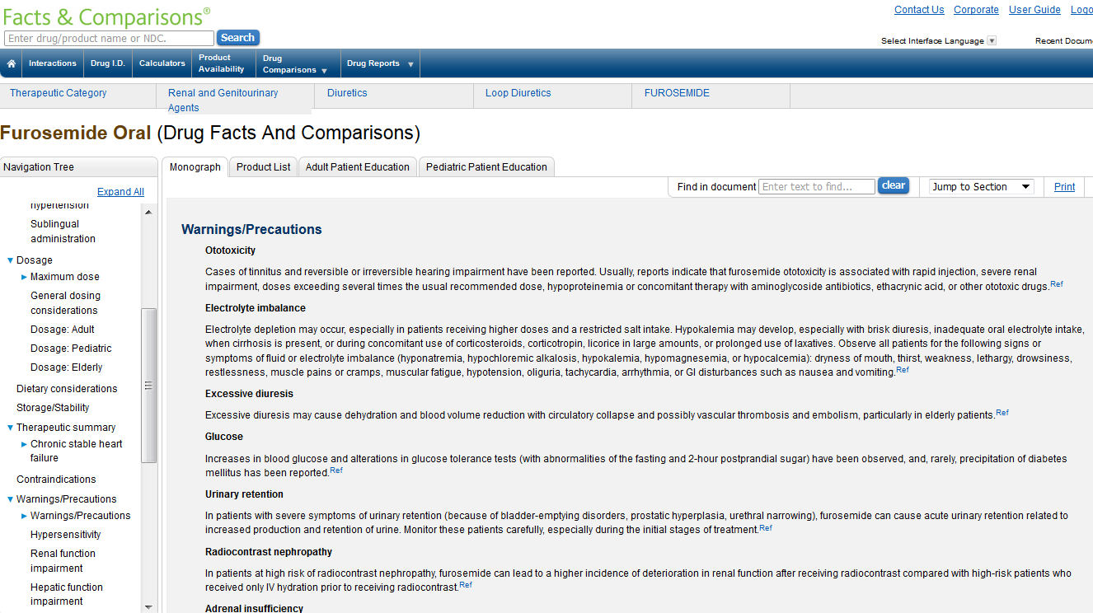
Navigation Drug Monograph

Slide 41
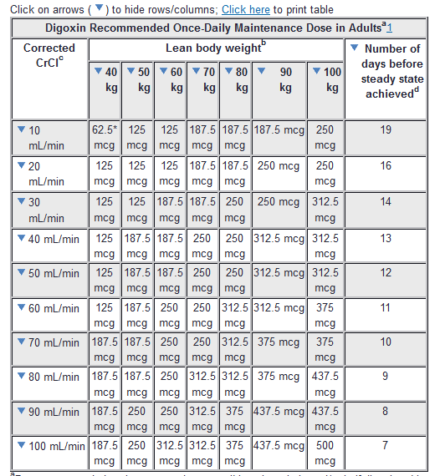
Tables in Facts and Comparisons
Teaching opportunities
Renal dosing
Compare drugs in class:
Adverse Effects
Indications
Drug-Pregnancy
Drug-Lactation
Contraindications/Precautions
Drug-Drug Interactions
Drug-Food Interactions
Drug-Alcohol Interactions
Notes:
You can search by drug class and look through the list of hits for the classifications, or just browse using the Resources link to Drug Facts & Comparisons, then find the type of agents, then class and drill down.

Slide 42
Exercises for Practice
Using Facts and Comparisons Online
Is it possible that Wellbutrin causes tinnitus? (hint: CTRL-F)
Which of the proton pump inhibitors are used off label for GERD in children?

Slide 43
Facts Drug Interactions
Can enter patient age, gender, drugs, allergies, and condition
Information very detailed
Each interaction linked to a monograph
Each monograph included Significance, Onset, Severity (3 levels) and the level of documentation of this interaction.

Slide 44
Exercises for Practice
digoxin, furosemide, lisinopril
lisinopril, metformin, and hydrochlorothiazide
Peds example: isoniazid, rifampin, ethambutol, acetaminophen

Slide 45
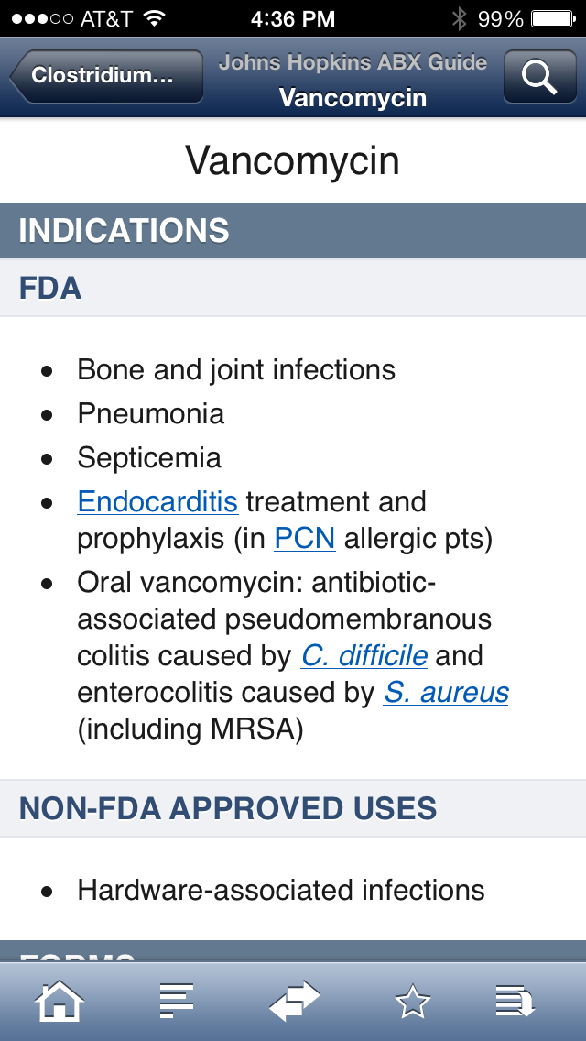
Johns Hopkins ABX
uCentral
Web and Mobile

Slide 46
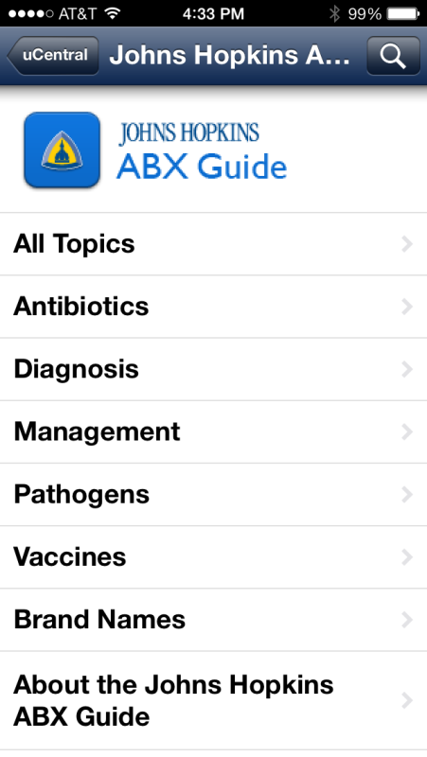
Johns Hopkins ABX Guide
Look up by bug, drug or disease
Section on Vaccines includes vaccine/drug interactions, contraindications
Notes:
You can look up the bug, drug or condition in Johns Hopkins. There are also chapters on Vaccines and brand names. I find searching all topics works best. The mobile app is really nice to use. Fast and logically laid out.

Slide 47
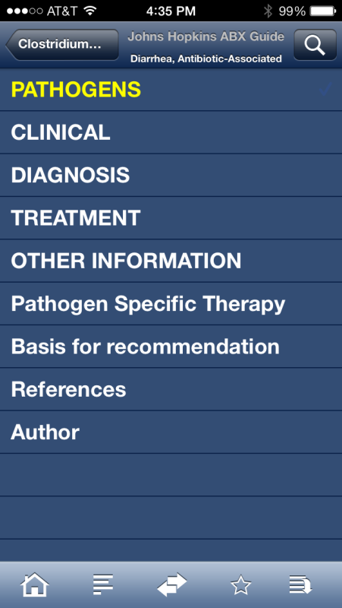
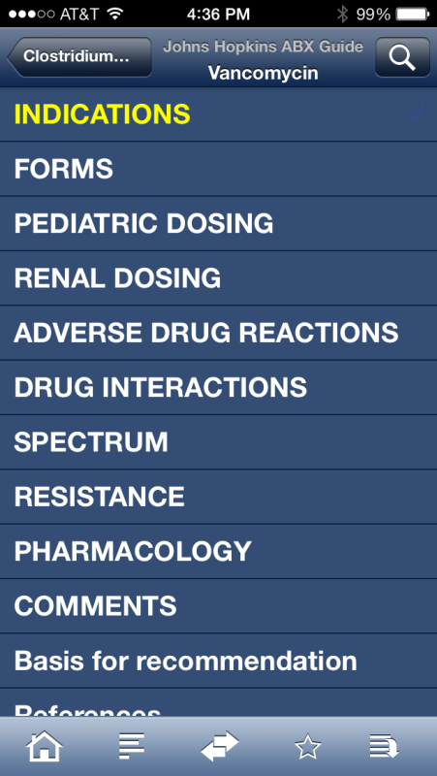
Pathogen vs Condition vs Antibiotic

Slide 48
Dynamed Plus- Evidence based
P | Rx Monographs
P | OTC Monographs
P | Alt Meds Monographs
 | Drug Interaction Tool
 | Drug Costs
 | Dosage Calculator
 | Formulary Tool
 | Patient Ed Handouts
 | Antibiotics Guide
 | Immunizations
Notes:
Dynamed Plus – has all of the preparations of the product, even when it is combined with other drugs- example acetaminophen – extensive tables under “Preparation”
Drug costs in form of “Comparative Costs” but not for every product

Slide 49
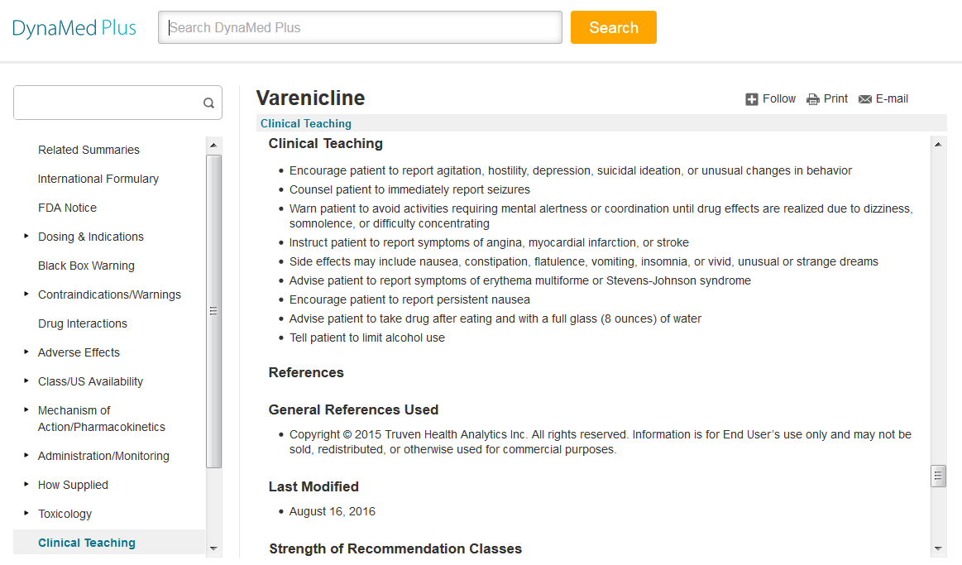
Dynamed Plus Drug Topics
Now contains Micromedex Drug monographs

Slide 50
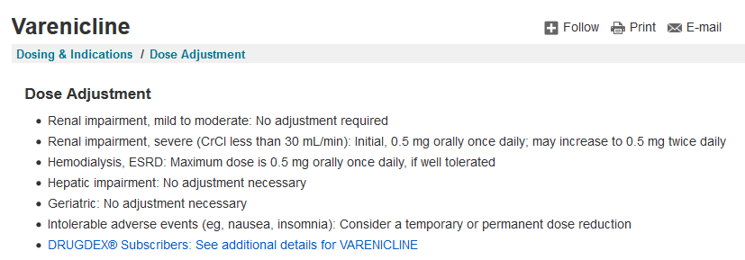
Dynamed Plus Teaching Opportunities
Renal impairment dosing (Dosing Adjustments)
Geriatric dosing
What is the evidence for using that drug?
Notes:
Search for zinc common cold and see evidence for using zinc. Or St john’s wort and depression.

Slide 51
Access Medicine
P | Rx Monographs
P | OTC Monographs
 | Alt Meds Monographs
 | Drug Interaction Tool
P | Drug Costs
 | Dosage Calculator
 | Formulary Tool
 | Pill Identifier
 | Antibiotics Guide
 | Immunizations
Notes:
Here is a mention…

Slide 52
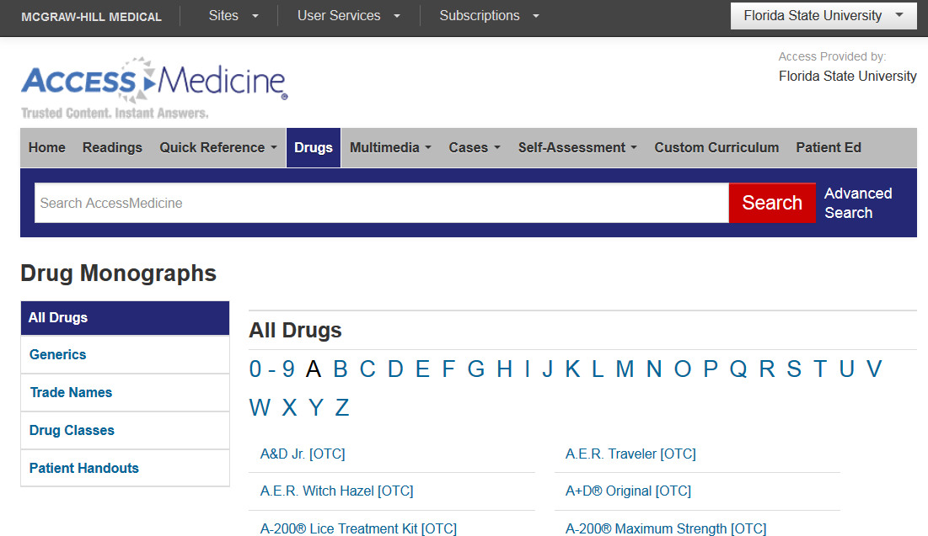
LexiDrugs in Access Medicine
Access Medicine Lexi Drug Content (Rx and OTC)
Notes:
Access Medicine contain excellent monographs from Lexi Drugs. The drug content on any of these sites can also be found under their DRUGs tab. You can’t easily search for a drug monograph, but basically have to use the alphabetical browsing method, which is inefficient. Access Medicine’s new site is mobile formatted to optimize use on iPads and smartphones. However, it still needs work.

Slide 53
ClinicalKey
P | Rx Monographs
P | OTC Monographs
P | Alt Meds Monographs
 | Drug Interaction Tool
 | Drug Costs
 | Dosage Calculator
 | Formulary Tool
 | Pill Identifier
 | Antibiotics Guide
 | Immunizations
Notes:
Here is a mention…

Slide 54
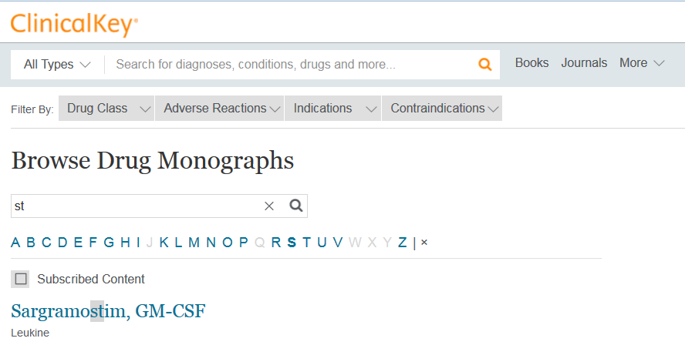
ClinicalKey Drug Monographs
From Gold Standard

Slide 55
Natural Medicines
 | Rx Monographs
 | OTC Monographs
P | Alt Meds Monographs
P | Drug Interaction Tool
 | Drug Costs
 | Dosage Calculator
 | Formulary Tool
 | Pill Identifier
 | Antibiotics Guide
 | Immunizations

Slide 56
Natural Medicines
Online and mobile
Effectiveness Checker
Drug Interaction Checker
Nutrient Depletion Checker includes prescription drugs
Clinical management series offers CME
Notes:
The Natural Medicines Database is a much more comprehensive database for information on alternative medicines, for which we also have a subscription. If you want additional information on an alternative medication, the monographs in this resource are much more detailed than the Epocrates content.
Contains a natural Product Effectiveness checker, and a natural products drug interaction checker.

Slide 57
Natural Medicines Effectiveness
Select condition
Provides clinical evidence for natural therapies broken down by:
Likely effective
Possibly effective
Possibly ineffective
Likely ineffective
Insufficient evidence

Slide 58
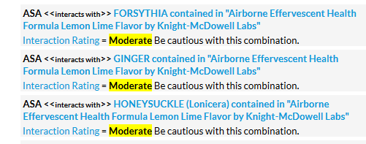
Interaction Checker
Enter prescription meds, foods, OTC multi-ingredient products, and alt meds
Breaks down all ingredients
Lists all interactions

Slide 59
Exercises for Practice
Drug interactions: lisinopril, metformin, hydrochlorothiazide and Airborn
What is the evidence of effectiveness for St. John’s Wort for depression? What other alternative therapies are effective for depression?

Slide 60
Pediatric care online
 | Rx Monographs
 | OTC Monographs
 | Alt Meds Monographs
 | Drug Interaction Tool
 | Drug Costs
 | Dosage Calculator
 | Formulary Tool
 | Pill Identifier
P | Antibiotics Guide
 | Immunizations

Slide 61
Pediatric Care Online
Antimicrobial Therapy Guide
Information by Diagnosis, Agent, Class
Limited number of conditions
Notes:
PCO does not have as much content as Epocrates.

Slide 62
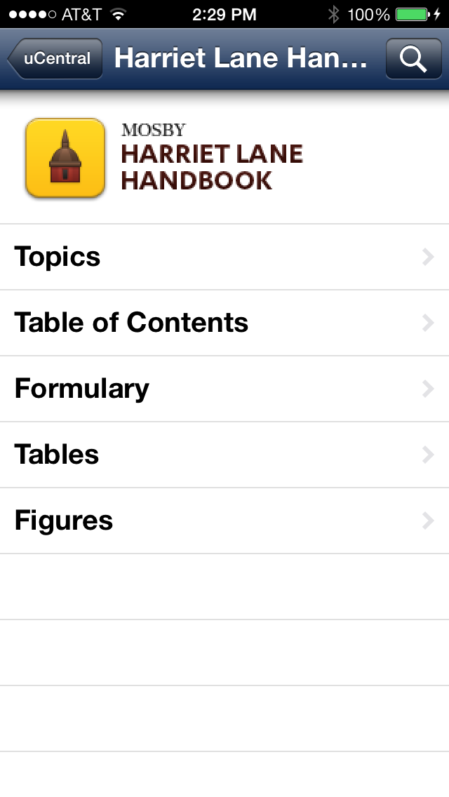
Harriet Lane
In uCentral

Slide 63
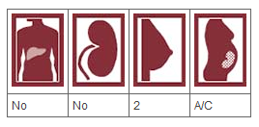
Harriet Lane
Best resource for pediatric dosing drugs approved for children
Formulary includes dosing by indication for each age group including infants ⬄ adults

Slide 64
Renal, Hepatic, Geriatric Dosing
Epocrates limited⬇
Some in Pepid
Best resources:
Dynamed Plus (Dosing: Special Populations)
Facts and Comparisons
Harriet Lane (Chapter 31 – Drugs in Renal Failure) Tables

Slide 65
Summary
PEPID competes well with Epocrates as a one-stop quick shop
Facts and Comparisons and Dynamed Plus for detail
Infectious disease: Johns Hopkins over all others
Peds dosing: Harriet Lane
Look for opportunities to increase students clinical reasoning and patient centered implications in regards to the drug information they find

